Slide 1
Leukemias in children
Dr.K.N. KARTHIC SUMAN NATH
1

Slide 2
Objectives
Definition & Classification of leukemias
The pathophysiology and epidemiology
of Acute lymphoblasticleukemia (ALL) Review the different drugs, & therapy strategies in ALL treatment.
Describe some of the newer agents for the treatment of ALL
2

Slide 3
Definition
Leukemia is a type of cancer of blood or bonemarrow
Characterized by an abnormal increase of immature white blood cells called "blasts".
Leukemia is a broad term covering a spectrum of diseases.
Leuka = white, emia = blood
3

Slide 4
Epidemiology
Most common childhood cancer
3,000 new cases each year
Demographics:
Males more commonly than females
–
–
Whites more than blacks
More commonly in patients with Down’s
4

Slide 5
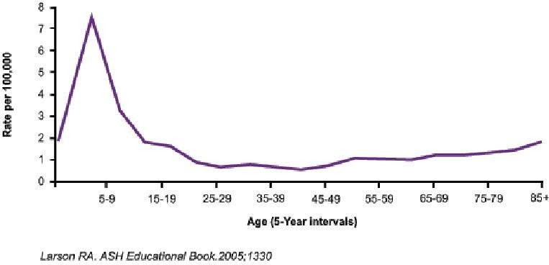
Age Incidence
5

Slide 6
Classification of leukemias
Cell type | Acute | Chronic
Lymphocytic leukemia (or "lymphoblastic") | Acute lymphoblastic leukemia(ALL) | Chronic lymphocytic leukemia(CLL)
Myelogenous leukemia (also "myeloid" or "nonlymphocytic") | Acute myelogenous leukemia(AML) (or myeloblastic) | Chronic myelogenous leukemia(CML)
6

Slide 7
Acute LymphoblasticLeukaemia
7

Slide 8
Epidemiology of ALL
peak incidence in 2 to 6 years more in boys than girls. median age in adults-35years
Etiology
less studied environmental and genetic factors
8

Slide 9
Factors predisposing ALL
GENETIC | ENVRONMENTAL
Down’s | Ionising radiation
Fanconi,diamond blackfan | Drugs
NF Type1 | alkylating agents
Ataxia telengiectasia | nitrosourea
turner | epipodophyllotoxin
klinefelter | benzene exposure
Li-fraumeni syndrome | advanced maternal age
Blooms syndrome | paternal smoking
9

Slide 10
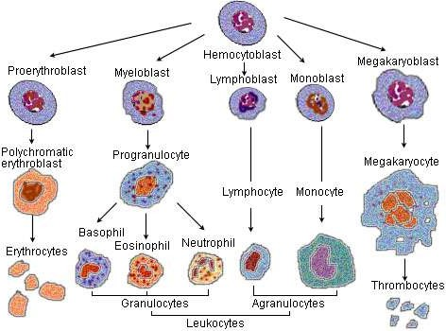
Hematopoisis
10

Slide 11
Blast cell
Blast cells are immature precursors of either lymphocytes (lymphoblasts), or granulocytes (myeloblasts).
They do not normally appear in peripheral blood. they can be recognized by their large size, and primitive nuclei (i.e. the nucleus contain nucleoli).
Presence of BS in blood, signify ACUTE LEUKEMIA.
Presence of an Auer Rod, is pathognomonic for Acute Myeloid Leukemia.
11

Slide 12
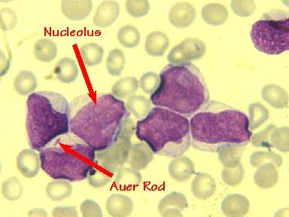
Blast cell
12

Slide 13
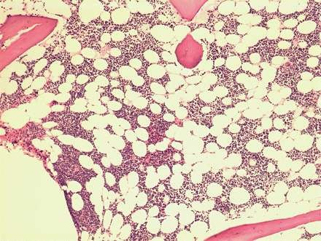
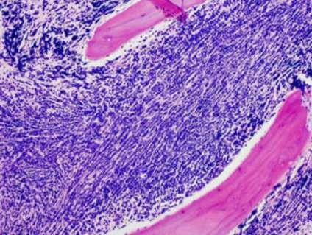
Bone marrow changes
Entire marrow replaced
Normal marrow
by blast
13

Slide 14
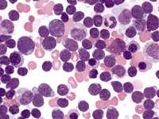
Marrow showing blasts
14

Slide 15
Classifications of ALL
FAB CLASSIFICATION
WHO CLASSIFICATION
Cyto-genetic CLASSIFICATION
15

Slide 16
FAB CLASSIFICATION OF ALL
CYTOLOGIC FEATURES | L1 | L2 | L3
Cell size | Small cells predominate,homo genous | Large,heterogenou s in size | Large homogenous
cytoplasm | Scanty | Variable,often moderately abundant | Moderately abundant
nucleoli | Small | One or more,often large | One or more,prominent
Nuclear size | Homogenous | Variable, heterogenous | Stippled, homogenous
Nuclear shape | Regular | Irregular clefts | regular
Cyt.basophilia | variable | variable | Intensely basophilic
Cyt.vacuolation 4/28/2014 | variable | variable | prominent 18

Slide 17
Classification of ALL(WHO)
Immunologic subtype | % of cases | FAB subtype | Cytogenetic abnormalites
Pre B ALL | 75 | L1,L2 | t(9;22),t(4;11 )t(1;19)
T cell ALL | 20 | L1,L2 | 14q11 or 7q34
Mature B cell ALL(burkitt | 5 | L3 | t(8;14)
leukemia)
28/2014 |  |  |  | 19
4/

Slide 18
Cytogenetic classification
TranslocationsinALL | Prognosis
t(12;21) | Good
t(1;19) | Poor
t(4;11)MLLfusion | Poor
JAK-2Mutation | Poor
t(9;22)BCR-ABL | Very Poor

Slide 19
ALL presentation
Anemia
Bleeding and bruising
Bone and joint pain
Fever
Weight loss

Slide 20
Etiology and Pathophysiology
ALL results from mutations of genes
– Radiation
–
–
Chemicals
Viruses & Other
Malignant immature white blood cells i.e. Lymphoblasts crowd out the bone marrow
T–his includes crowding out of platelets, RBCs, a– nd mature WBCs

Slide 21
CLINICAL FEATURES
Due to infiltration of marrow
SYMPTOMS
Due to decreased production of
normal marrow elements

Slide 22
Symptoms
symptoms | percentage
fatigue | 92
Bone or joint pain | 79
fever | 71
Weight loss | 66
Abnormal masses | 62
purpura | 51
hemorrhage | 27
infection 4/28/2014 | 17 24

Slide 23
Physical Signs
Physical Signs | percentage
splenomegaly | 86
lymphadenopathy | 76
hepatomegaly | 74
Sternal tenderness | 69
purpura | 50
Fundus changes | 14

Slide 24
Clinical features
Generalized weakness and fatigue
Anemia
Frequent or unexplained fever and infection
Weight loss and/or loss of appetite
Excessive and unexplained bruising
Bone pain, joint pain (caused by the spread of "blast" cells from the marrow cavity)
Breathlessness
Enlarged lymph nodes, liver and/or spleen
Petechiae, which are tiny red spots or lines in the skin due to low platelet levels

Slide 25
Diagnosis
Confirmative tests
Supportive tests

Slide 26
Investigation (supportive)
LDH,Serum uric acid
Coagulation profile
LFT,RFT
Chest x-ray,
CT scan of chest & brain
Blood culture
Baseline Echo,ECG

Slide 27
Investigation (confirmative)
CBC
Bone marrow aspiration/biopsy
Cyto genetics.

Slide 28
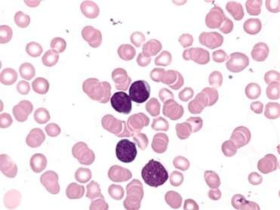
Investigations(conf.)
CBC-Anemia,thrombocytopenia,leucopenia or leucocytosis.
Peripheral smear study-circulating blast can be seen.

Slide 29
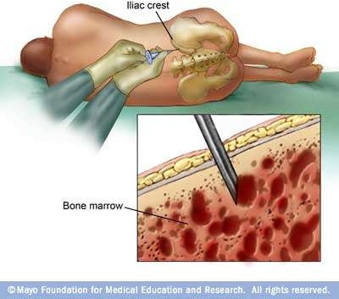
Confirmatory
Bone marrow aspiration/biopsy

Slide 30
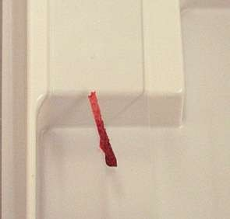
Bone marrow biopsy
gross specimen
Marrow showing blasts

Slide 31
Criteria for diagnosis
Bone marrow or peripheral smear showing
Aleast 30% blast(FAB) Atleast 20%blast (WHO)

Slide 32
Treatment
Pre Chemotherapy supportive care Chemotherapy
Preinduction
Remission induction-phase 1 & 2 Reinduction
CNS preventive therapy consolidation Maintenance therapy
Allogenic stem cell transplantation Newer drugs
Supportive care Treatment of relapse Effects of treatment

Slide 33
Supportive care
Treat metabolic complications hyperuricemia - hydration,rasburicase hyperphosphatemia - po4 binders hypocalcemia - Ca supplements
Hyperleuckocytosis - leukopharesis Infection control-broad spectrum
antibiotics
Hematologic support

Slide 34
Preinduction
Prednisolone 1mg/kg p.ofor 5 days
Recheck blast after 5 days, if blast count dropped-good response.

Slide 35
Treatment of ALL Induction 1
cycle | chemotherap y | Dose and schedule
Induction | Prednisolon or | 1mg/kg p.o days 1-28 days
 | vincristine | 1.5mg/m2 i.v weekly once x 4 weeks
 | doxorubicin | 30mg/m2 i.v weekly once x 4 weeks
 | L-Asparginase | 1,00,000 u/m2(total dose) in divided doses of 10,000 u daily for 10 days
CNS Proph. | methotrexate | 12mg IT days 1,8,15,22

Slide 36
Reassess
After 4 weeks of phase 1 induction assess marrow for remission.
If there is remission taper prednisolone and after 1 week, start phase2 induction,
If there is no remission give 2 more weekly doses of vincristine and doxo and then assess, if still no remission go for alternate regimen.

Slide 37
Induction 2
Induction2 | drugs | Dose and schedule
 | Cyclophosphamide Cytosine arabinoside | 650mg/m2 i.v days 1 and 15 75mg/m2 i.v x 4 days a weeks for 4 week
 | methotrexate | 12mg/m2 IT days 1,8,15,22
 | Cranial radiation | 200 cGy x 9days

Slide 38
Reinduction
Re induction | drug | Dose and schedule
 | vincristine | 1.5 mg/m2 i.v weekly one dose on day 1 and 8
 | doxorubicin | 30mg/m2 i.v. weekly one dose on day 1 and 8
4/28/2014 | prednisolone | 1mg/kg p.o daily for 14 days 40

Slide 39
Consolidation(2weeks)
consol dation | drugs | Dose and schedule
 | cyclophosp hamide | 750/m2 .i.v on days 1 and 15
 | Cytosine arabinoside | 75mg/m2 doses days 1-4 and 15-18
4/28/2014
41

Slide 40
Maintenance phase duration- upto 2 years
maintena nce | drug | Dose and schedule
₁st month | methotrexate | 12.5mg i.t on day 1
 | vincristine | 1.4mg/m2 i.v day 1
 | prednisolone | 1mg/kg p.o daily day 1-7
 | 6 mercaptopurine | 60mg/m2 p.o. daily for next 3 weeks
 | methotrexate | 15mg/m2 p.o. once a week for 3 weeks.
₂nd month 4/28/2014 | 6 MCP and T.Methotxerate for 4 weeks. | 42

Slide 41
Follow up
If the patient completes chemotherapy for 2 years without relapse-stop chemo and follow up.
No relapse within 5 years-can be declared as cured.

Slide 42
Allogenic stem cell transpantation
Usually done in second remission.
Can be done in first remission in high risk patients
WBC>25000,
philadelphia chromosome positive, poor initial response to remission induction.

Slide 43
Newer drugs
Monoclonal antibodies rituximab(CD20),epratuzumab(CD22) alemtuzumab(CD52),gemtuzumab(CD33)
Antimetabolites clofarabine,nelarabine
Tyrosine kinase inhibitor imatinib, nilotinib, dasatinib,
Vornistat, sirolimus,everolimus,oblimersen.

Slide 44
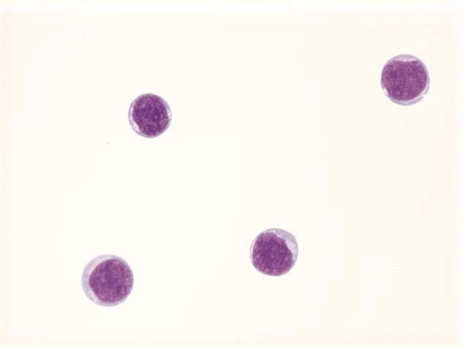
CNS Prophylaxis

Slide 45
CNS Prophylaxis
CNS involvement at diagnosis <5%
Without prophylaxis, over 80% of patients in CR will relapse in the CNS
With prophylaxis, less than 5% have CNS relapse
Intrathecal chemotherapy is now the mainstay
– Sample intermediate risk regimen: IT MTX alone or “triple therapy”: IT cytarabine Day 1 of CR followed by MTX/hydrocortisone/cytarabine
47
Pui CH, Howard SC. Lancet Oncol 9 (3): 257-68, 2008
4/28/2014

Slide 46
Prognostic factors in ALL
Determinants | Favourable | unfavourable
WBC Counts | <10,000 | >2,00,000
Age | 2-10 years | <1yr,>10yr
Gender | female | male
Ethnicity | white | black
Node,liver,splenomegaly | absent | massive
Testicular enlargement | absent | present
CNS involvement | absent | Csf blast and pleocytosis
FAB Type | L1 | L2
Cytogenetics | T(12;21)(TEL-AML1) Trisomies 4,10,17 | t(9;22)(bcr-abl) t(4;11)(MLL-AF4)
Ploidy | hyperdipoidy | hypodiploidy
T_{4/2}i₈m_{/20}e₁₄to remission | <14days | >28days ₄₈

Slide 48
LYMPHOMA
3rd most common cancer in children Incidence is 15 per million children Two broad categories
Hodgkin disease
Non- Hodgkin disease

Slide 49
HODGKIN DISEASE:
Malignant process of lymphoreticular system
6% of childhood cancer
5% of cancer in < 14 yr
15% in person 15-19 yr
Rare < 10 yr

Slide 50
Epidemiology
Bimodal incidence
Early peak middle to late 20s
Second peak after 50 yr
Sex Male : Female
4: 1 for 3-7 yr
3: 1 for 7-9 yr
1-3: 1 for > 10 yr
100 folds risk for unaffected monozygotic twin of affected twin
Associated with specific HLA antigen
Infectious agents
Human herpes virus 6, CMV, Epstein – Barr virus
Immunodeficiency

Slide 51
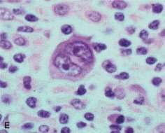
ETIOLOGY
Reed –Sternberg cell Hallmark of disease
Large (15-45 mm) multiple
/ multilobulated nuclei Colonal in origin
Arises from germinal center B cells

Slide 52
RYE CLASSIFICATION SYSTEM
Lymphocyte predominant
Mixed cellularity
Nodular sclerosis
Lymphocyte depletion

Slide 53
Lymphocyte Predominant
10-15% of patients More common in male Younger patients Localized disease Mixed cellularity 30% of patients
< 10 yr of age Advanced disease Extranodal extension

Slide 54
Lymphocyte depletion Rare in children Common with HIV Nodular sclerosis
Most common
40% of younger patients 70% of adolescents

Slide 55
REAL Classification
( Revised European – American Classification of Lymphoid Neoplasms )
Nodular lymphocyte predominance
Classical Hodgkin lymphoma
Lymphocyte rich
Mix cellularity
Nodular sclerosis
Lymphocyte depletion
Anaplastic large cell lymphoma Hodgkin like

Slide 56
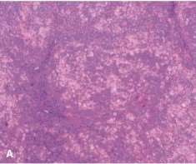
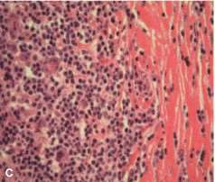
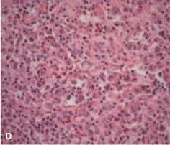
Lymphocyte predominant
Nodular sclerosis
Mixed cellularity
Reed-Sternberg Cell

Slide 57
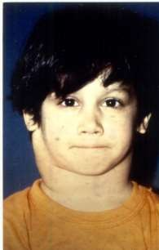
CLINICAL MANIFESTATIONS
Lymphadenopathy cervical / supraclavicular
Painless, non tender, firm and rubbery
Hepatosplenomegaly
Cough, dyspnoea, hypoxia
Pleural or pericardial effusion
Hepatocellular dysfunction
B.M infiltration
(Anemia, neutropenia, thrombocytopenia)
Disease below diaphragm is rare (only3%)

Slide 58
Systemic Symptoms (B symptoms)
Important in staging
Unexplained fever > 39 degree centigrade
Weight loss > 10% in 3 months
Drenching night sweats
Immune System abnormalities
Allergy to delayed-hypersensitivity skin test
Abnormal cellular immune response
Decreased CD4:CD8 ratio
Reduced natural killer cell cytotoxicity

Slide 59
DIAGNOSIS
Excisional Biopsy
Light Microscopy
Immunocytochemistry
Molecular Studies
Chest X – Ray
Mediastinal Mass
CT Scan
Chest
Abdomen
Pelvis
Blood CP & ESR
LFT’s
Bone Marrow Aspiration
Serum Copper & Ferritin
Bone Scan
Gallium 67 Scan / FDG/PET
(fludeoxyglucose)

Slide 60
Stage I
ANN ARBOR STAGING CLASSIFICATION FOR HODGKIN DISEASE
Involvement of a single lymph node (1)
or of a single extra lymphatic site or organ(1_{f})
Stage II
Involvement of two or more lymph node regions on the same side of the diaphragm(II)
or localised involvement of an extra lymphatic site or organ and one or more lymph node regions
on the same side of the diaphragm (II_{f})

Slide 61
Stage III
Involvement of lymph node regions on both sides of the diaphragm (III) which may be accompanied by the
involvement of spleen (IIIS) or by localized involvement of an extra lymphatic site or organ ( IIIf) or both ( IIIsf)
Stage IV
Diffuse or disseminated involvement of one or more
extra lymphatic organs or tissues with or without associated lymph
node involvement.
The absence or presence of fever > 38C for three consecutive days , drenching night sweats , or unexplained loss of > 10% body weight in the 6 months preceding admission are to be denoted in all cases by the suffice letters A & B respectively.

Slide 62
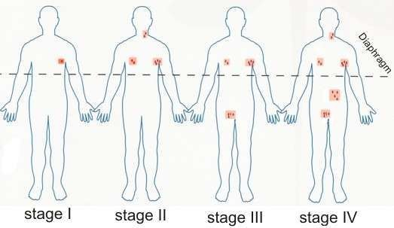

Slide 63
Treatment depends on :
TREATMENT
Stage of the disease Age at diagnosis
Presence / absence of B symptoms Presence of hilar lymphadenopathy Presence of bulky nodal disease Current Treatment Regimen
Combined chemotherapy with or without low dose involved field radiation therapy

Slide 64
MOPP
(Mechlorethamine , Vincristine , Procarbazine , Prednisolone)
Chemotherapy Regimens
COPP
(Cyclophosphamide , Vincristine , Procarbazine , Prednisolone)
ABVD
(Adriamycin , Bleomycin , Vinblastine , Dacarbazine)
BEACOPP ( For advanced stage disease ) (Bleomycin , Etoposide , Doxorubicin , Cyclophosphamide , Vincristine , Procarbazine , Prednisolone)

Slide 65
PROGNOSTIC FACTORS
Prognosis
FAVORABLE:
<10, F, favorable subtypes (LP and NS)
and
Stage I non-bulky disease
UNFAVORABLE:
Persistently elevated ESR;
LD histopathology;
bulky disease--largest dimension >10cm;
B symptoms;

Slide 66
LONG TERM COMPLICATIONS
Secondary malignancy
Acute Myelogenous Leukemia
Non Hodgkin lymphoma
Carcinomas of breast , lungs & thyroid Short stature
Hypothyroidism Sterility
Dental caries
Sub clinical pulmonary dysfunction Ischemic heart disease

Slide 67
Early Stage Disease
5 year survival ….95% Advanced Stage Disease 5 year survival ….90%
PROGNOSIS
Relapses common within first 3 years from diagnosis
Relapses treated with Autologous Stem Cell Transplantation

Slide 69
EPIDEMIOLOGY
6% of childhood cancer 60% of all lymphomas in children(M:F 2.5:1)
8-10% of all malignancies in children between 5- 19 yrs of age
Secondary causes of NHL include;
Inherited / acquired immune deficiencies
Viruses
HIV
EBV
Post BMT, Post solid organ transplant
Ataxia Telangiectasia
Bloom syndrome

Slide 70
PATHOLOGICAL SUB TYPES OF NHL
Burkitt Lymphoma
40% of NHL
B Cell Origin
Lymphoblastic Lymphoma
30% of NHL
80% T Cell Origin & 20% B Cell Origin
Diffuse Large B Cell Lymphoma
20% of NHL
B Cell Origin
Anaplastic Large Cell Lymphoma
10% of NHL
70% T Cell Origin

Slide 71
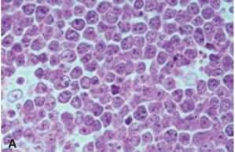
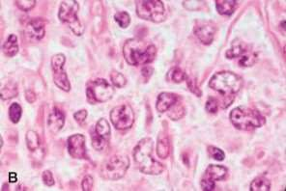
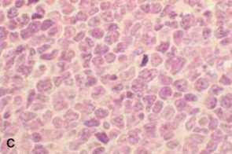
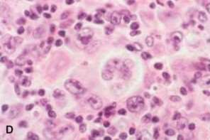
Burkitt Lymphoma
Diffuse Large B Cell Lymphoma
T lymphoblastic Lymphoma
Anaplastic Large Cell Lymphoma

Slide 72
Lymphoblastic (30-35%)
90 % immature T cells (very similar to T-ALL)
remainder pre-B phenotype (as in ALL) 50-70% anterior mediastinum neck, supraclavicular, axillary
adenopathy
Classic: older child with intussusception

Slide 73
Small non-cleaved cell (40-50%)
--Mature B-cell phenotype
--Burkitt's and non-Burkitt's
--90% abdomen
--Ascites and intusussception
--Endemic in Africa (Burkitt's), with EBV 97%

Slide 74
Large-cell lymphoma (15-20%)
Anaplastic (Ki-1) lymphoma – ALK fusion protein
Diffuse Large B-cell lymphoma (DLBCL)
frequent Mediastinal involvement
More like Hodgkin lymphoma than other NHLs
“Peripheral T-cell” lymphoma
Often involves skin, CNS, lymph nodes, lung, testes, muscles, and GI tract

Slide 75
CLINICAL MANIFESTATIONS
Burkitt Lymphoma Abdominal Tumor Head & Neck Disease
Involvement of bone marrow & CNS
Lymphoblastic Lymphoma
Intrathoracic / mediastinal supradiaphragmatic mass Involvement of bone marrow & CNS
Diffuse Large B Cell Lymphoma Abdominal Mass/ Mediastinal Mass Anaplastic Large Cell Lymphoma Primary cutaneous manifestation Systemic disease ( fever , weight loss)
Dissemination to liver , spleen , lung , mediastinum & skin

Slide 76
CLINICAL MANIFESTATIONS ( cont )
Lymphadenopathy
Superior vena cava syndrome
Dyspnea
Abdominal Mass
Intestinal obstruction / intussusception
Ascites
Nasal Stuffiness
Earache
Tonsil enlargement
Localised bone involvement
Acute paraplegia secondary to CNS / spinal cord
compression
Tumor Lysis Syndrome

Slide 77
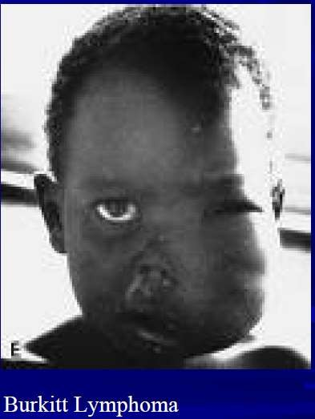
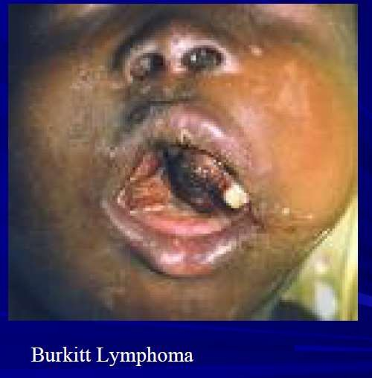

Slide 78
Staging system for childhood Non- Hodgkin lymphoma
Stage Description
A single tumor (extranodal) or single anatomic area (nodal) with the exclusion of mediastinum
or abdomen
A single tumor (extranodal) with regional node Involvement two or more nodes areas on the same side of diaphragm
Two single (extranodal) tumors with or without the regional node involvement on same side of diaphragm A primary gastrointestinal tract tumor usually in the ileocecal area, with or without involvement of associated mesenteric nodes, which may must be grossly ( > 90%) resected

Slide 79
Stage III Two single tumors (extranodal) on opposite side of the diaphragm
Two more nodal areas above and below the diaphragm
Any primary intarthoracic tumor (mediastinal, pleural, or thymic)
Any extensive primary intra – abdominal disease
IV Any of the above, with initial involvement of central nervous system or bone marrow at time of diagnosis

Slide 80
DIFFERENTIAL DIAGNOSIS
Hodgkin Disease
Leukemia
Germ Cell Tumor
Wilms Tumor
Neuroblastoma
Rhabdomyosarcoma
Reactive lymphadenitis

Slide 81
LABORATORY FINDINGS
Tissue biopsy for;
Flow cytometry
Karyotyping
Complete Blood Count
Serum Electrolytes, Calcium , Phosphorus , Uric acid
LFT’s & RFT’s
Bone Marrow Aspiration & Biopsy
CSF Examination
Chest X Ray
CT Scan
Head & Neck
Chest
Abdomen & Pelvis
PET Scan & Bone Scan

Slide 82
TREATMENT
Systemic Chemotherapy
Intrathecal chemotherapy
Radiotherapy indicated in ;
CNS Disease
SVC Syndrome
Paraplegia

Slide 83
Chemotherapy Regimens
COPAD
(Cyclophosphamide ,
vincristine, Prednisolone , Doxorubicin)
COMP
(Cyclophosphamide , Vincristine , Methotrexate , 6 Mercaptopurine , Prednisolone)

Slide 84
Duration of Treatment
Burkitt Lymphoma & Diffuse Large B Cell Lymphoma ………. 6 weeks to 6 months
Lymphoblastic Lymphoma …..24 months

Slide 85
Supportive Treatment
G-CSF prophylaxis for fever & neutropenia
Antibiotic prophylaxis
Blood & platelet transfusions
Allopurinol
Parenteral nutrition

Slide 86
COMPLICATIONS
Infections
Mucositis
Pancytopenia
Electrolyte imbalance
Poor nutrition
Growth retardation
Cardiac Toxicity
Gonadal Toxicity with Infertility
Secondary malignancies

Slide 87
PROGNOSIS
Localized disease 90 – 100% survival Advanced Disease
60-95% survival

Slide 88
THANK YOU
4/28/2014
49

